Slide 1


Data Management
Tutor: Ms Low Jia Xin Contact: 65500529
Email: low_jia_xin@nyp.edu.sg

Slide 2
Week 7 Topics
Official (Open)
Combining Data using JOIN Clauses
Inner Join (More than 1 table adding them together)
Left Outer Join
Right Outer Join
Full Outer Join

Slide 3

J O I N
Official (Open)
We use JOIN to combine data from the different table, where they are related and linked to each other.
Syntax:
SELECT <columnname> FROM Table 1
<INNER | LEFT OUTER | RIGHT OUTER | FULL OUTER> JOIN Table2
ON Table1.<columnname> = Table2.<columnname> WHERE <condition> (optional)
Notes:
For example, they have the same column name

Slide 4
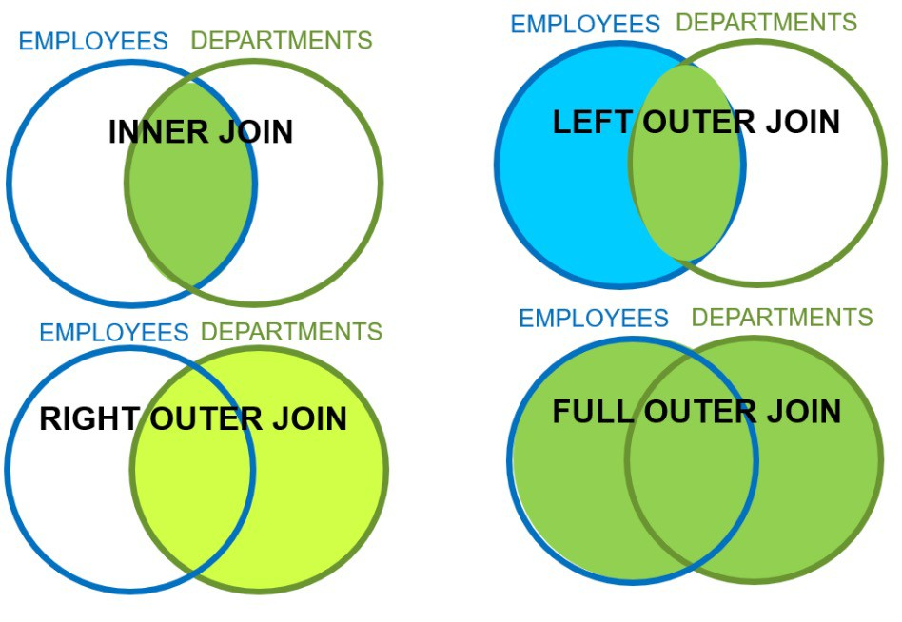
Different type of joins
Official (Open)

Slide 5

Inner Join
Official (Open)
Retrieves only the rows that have a field match in both the joined tables.
Syntax:
SELECT <columnname> FROM Table 1
INNER JOIN Table2
ON Table1.<columnname> = Table2.<columnname>
Notes:
Inner join is the intersection

Slide 6

Inner Join – Example 1
StudentInfo
Official (Open)
Excluded because the admin number does
not appear in the ExamResults table
ExamResults
AdminNo | Name | Gender
123456A | Jack | M
128876B | Kate | F
125673C | Mike | M
AdminNo | Subject | Marks
123456A | English | 89
123456A | Maths | 66
128876B | English | 77
SELECT StudentInfo.AdminNo, StudentInfo.Name, ExamResults.Subject,
<Column name>
ExamResults.Marks FROM StudentInfo INNER JOIN ExamResults
ON StudentInfo.AdminNo = ExamResults.AdminNo;
<Column name>
Output:
<Table 1>
AdminNo | Name | Subject | Marks
123456A | Jack | English | 89
123456A | Jack | Maths | 66
128876B | Kate | English | 77
<Table 2>
Notes:
Select admin number, name in the Student Info,
Subject and Marks from ExamResult
Then,
Selected column from Student Info and ExamResults are joined together
ON the correspond of each table similar admin number
FROM the StudentInfo table, join it with the ExamResults table
( ON – how the table should be joined [conditions] )
With conditions of looking based on the AdminNo where the data form the left correspond to the right
It will exclude the uncommon data such as Mike

Slide 7



Inner Join – Example 2
Customers
Official (Open)
Orders
CustID | OrderID | ProductID | Quantity
101 | 10640 | 11 | 5
101 | 10692 | 20 | 12
102 | 10600 | 11 | 20
104 | 10630 | 25 | 4
CustName | CustID | Company
Jack | 101 | TNJ PL
Ken | 102 | TDH PL
Leo | 103 | SSS PL
SELECT *
FROM Customers AS C INNER JOIN Orders AS R ON C.CusID = R.CustID;
Output:
CustName | CustID | Company | CustID | OrderID | ProductID | Quantity
Jack | 101 | TNJ PL | 101 | 10640 | 11 | 5
Jack | 101 | TNJ PL | 101 | 10692 | 20 | 12
Ken | 102 | TDH PL | 102 | 10600 | 11 | 20
Notes:
Take the common one
Select all from the customers table and join it with the orders table
With conditions of looking based on the customerID where the data form the left correspond to the right

Slide 8

Left Outer Join
Official (Open)
Syntax:
SELECT <columnname> FROM Table 1
LEFT OUTER JOIN Table2
ON Table1.<columnname> = Table2.<columnname>
Notes:
Returns data from the left table and only corresponding data from the right table as an output.

Slide 9


Left Outer Join – Example
Customers
Official (Open)
Orders
CustID | OrderID | ProductID | Quantity
101 | 10640 | 11 | 5
101 | 10692 | 20 | 12
102 | 10600 | 11 | 20
104 | 10630 | 25 | 4
CustName | CustID | Company
Jack | 101 | TNJ PL
Ken | 102 | TDH PL
Leo | 103 | SSS PL
Output:
SELECT *
FROM Customers AS C
LEFT OUTER JOIN Orders AS R ON C.CusID = R.CustID;
CustName | CustID | Company | CustID | OrderID | ProductID | Quantity
Jack | 101 | TNJ PL | 101 | 10640 | 11 | 5
Jack | 101 | TNJ PL | 101 | 10692 | 20 | 12
Ken | 102 | TDH PL | 102 | 10600 | 11 | 20
Leo | 103 | SSS PL | NULL | NULL | NULL | NULL
Notes:
Select everything from the customers table (left) and join it with the orders table
Everything from customers table will be shown but orders table will only show the correspond to the customers table
Since there is no ID 103 in orders table, the output will give a null value.
And there is no ID 104 in customers table, the output will exclude it even though it appear in the orders table

Slide 10

Right Outer Join
Official (Open)
Syntax:
SELECT <columnname> FROM Table 1
RIGHT OUTER JOIN Table2
ON Table1.<columnname> = Table2.<columnname>
Notes:
Show all the data from the right table even there is no matching or common data from the left table.

Slide 11
Right Outer Join – Example
Customers
Official (Open)
Orders
CustID | OrderID | ProductID | Quantity
101 | 10640 | 11 | 5
101 | 10692 | 20 | 12
102 | 10600 | 11 | 20
104 | 10630 | 25 | 4
CustName | CustID | Company
Jack | 101 | TNJ PL
Ken | 102 | TDH PL
Leo | 103 | SSS PL
Output:
SELECT *
FROM Customers AS C
RIGHT OUTER JOIN Orders AS R ON C.CusID = R.CustID;
CustName | CustID | Company | CustID | OrderID | ProductID | Quantity
Jack | 101 | TNJ PL | 101 | 10640 | 11 | 5
Jack | 101 | TNJ PL | 101 | 10692 | 20 | 12
Ken | 102 | TDH PL | 102 | 10600 | 11 | 20
NULL | NULL | NULL | 104 | 10630 | 25 | 4
Notes:
Select everything from the customers table (left) and join it with the orders table
Everything from customers table will be shown and orders table will only show even there is no matching or common data
Since there is no ID 104 in customers table, the output will give a null value.
And there is no ID 103 in orders table, output will exclude it even though it appear in the customers table
Show everything from the right table and the correspond data from the left, null for 104 as no correspond

Slide 12

Full Outer Join
Official (Open)
Syntax:
SELECT <columnname> FROM Table 1
LEFT OUTER JOIN Table2
ON Table1.<columnname> = Table2.<columnname> UNION
SELECT <columnname> FROM Table 1
RIGHT OUTER JOIN Table2
ON Table1.<columnname> = Table2.<columnname>
Notes:
Returns all data from both database tables

Slide 13
Full Outer Join – Example
Official (Open)
Customers
Orders
CustID | OrderID | ProductID | Quantity
101 | 10640 | 11 | 5
101 | 10692 | 20 | 12
102 | 10600 | 11 | 20
104 | 10630 | 25 | 4
SELECT *
FROM Customers AS C
LEFT OUTER JOIN Orders AS R ON C.CusID = R.CustID UNION
SELECT *
FROM Customers AS C
RIGHT OUTER JOIN Orders AS R Leo
ON C.CusID = R.CustID;
CustName | CustID | Company
Jack | 101 | TNJ PL
Ken | 102 | TDH PL
Leo | 103 | SSS PL
Output:
CustName
CustID
Company
CustID
OrderID
ProductID
Quantity
Jack
101
TNJ PL
101
10640
11
5
Jack
101
TNJ PL
101
10692
20
12
Ken
102
TDH PL
102
10600
11
20
103
SSS PL
NULL
NULL
NULL
NULL
NULL
NULL
NULL
104
10630
25
4
Notes:
Select everything from the customers table (left) and join it with the orders table
Everything from customers table will be shown but orders table will only show the correspond to the customers table
Since there is no ID 103 in orders table, the output will give a null value.
+
Select everything from the customers table and join it (right) with the orders table
Everything from customers table will be shown and orders table will only show even there is no matching or common data
Since there is no ID 103 in orders table, the output will give a null value.
And there is no ID 104 in customers table, the output will exclude it even though it appear in the orders table

